Slide 1

Dota 2
The Beginner's Guide
(Project Proposal)
Presented By:-
Sujoy Kar
Hardik Sankhla
Hussain Ul Abideen
Anurag Singh
CIS : 602 - 02 Special Topics
-Data Analytics

Slide 2
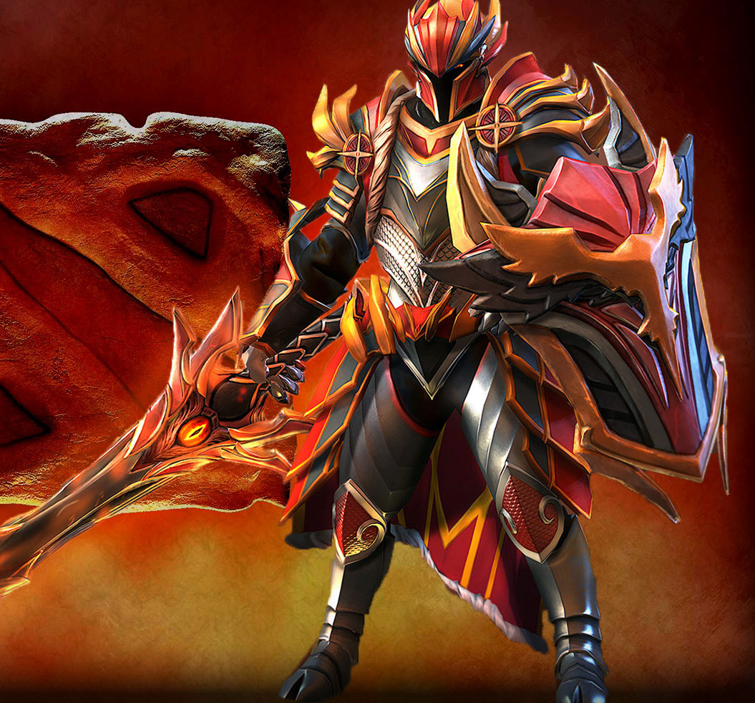
What is DOTA?
Defense of the Ancients (DotA) is a multiplayer online battle arena mod for video game Warcraft 3 where matches are played between 2 teams that consist of 5 players each trying to destroy each other’s base (The Ancients).
Is Dota that popular? Is there a need for a guide for beginners?
Dota has a total active player base as of 43.2 Million till August 2015 and still increasing day by day.
So, for giving the new players a friendly and competitive environment we decided to create a guide for them to understand the game in a much more easier way.
Credits : http://dota2walls.com/category/dragon-knight

Slide 3

Goal : Questions to be answered?
Q1. What is the best Item build for different Heroes in the game? – Frequent asked question by New players
Ans: To make your Hero strong you need proper in-game items to support your hero and team to the victory. So for that we wish to use certain algorithms to create the best item build guide for beginners. Like For example :
Q2. What is the best Skill build for a particular hero to get the best possible result in-game? – Important to New players
Ans: Every Hero in the game has different Skill sets, so eventually every hero shall have a different way of skilling up points in their skills depending on various gameplay style of players. So we wish to create the best possible build for new players which helps them win a game. Like For example:
Credits : http://dotawallpaper.org/wallpaper/lina/

Slide 4

Datasets : Where and How?
Q1. Where do we get our Datasets from?
Ans: Using Dota 2 Steam Server API - http://dev.dota2.com/showthread.php?t=58317
Q2. How do we plan to implement it?
Ans:
We plan to observe the data first.
Create a listing for the most popular items being used in the game.
Sort the items on the basis of Win% , most frequent bought item for a particular hero.
Create the Skill build in terms of Win%, most picked skill per level for each hero.
Credits : http://www.1zoom.net/Games/wallpaper/444105/z1978.8/

Slide 5

Visual Implementation? (Draft)
Bar Chart (Most popular Item picked)
Scatterplot (Trend in popularity of items being picked)
Tabular data comparison (Best Skill build)
Use of d3
Final Visualization may change in the course of the project depending on situations.
Credits : https://www.pinterest.com/pin/559220478704568605/

Slide 6

Questions?
Credits : https://s-media-cache-ak0.pinimg.com/originals/89/05/1d/89051d3468f62a35d614d30d53b8beb6.jpg

